Slide 1
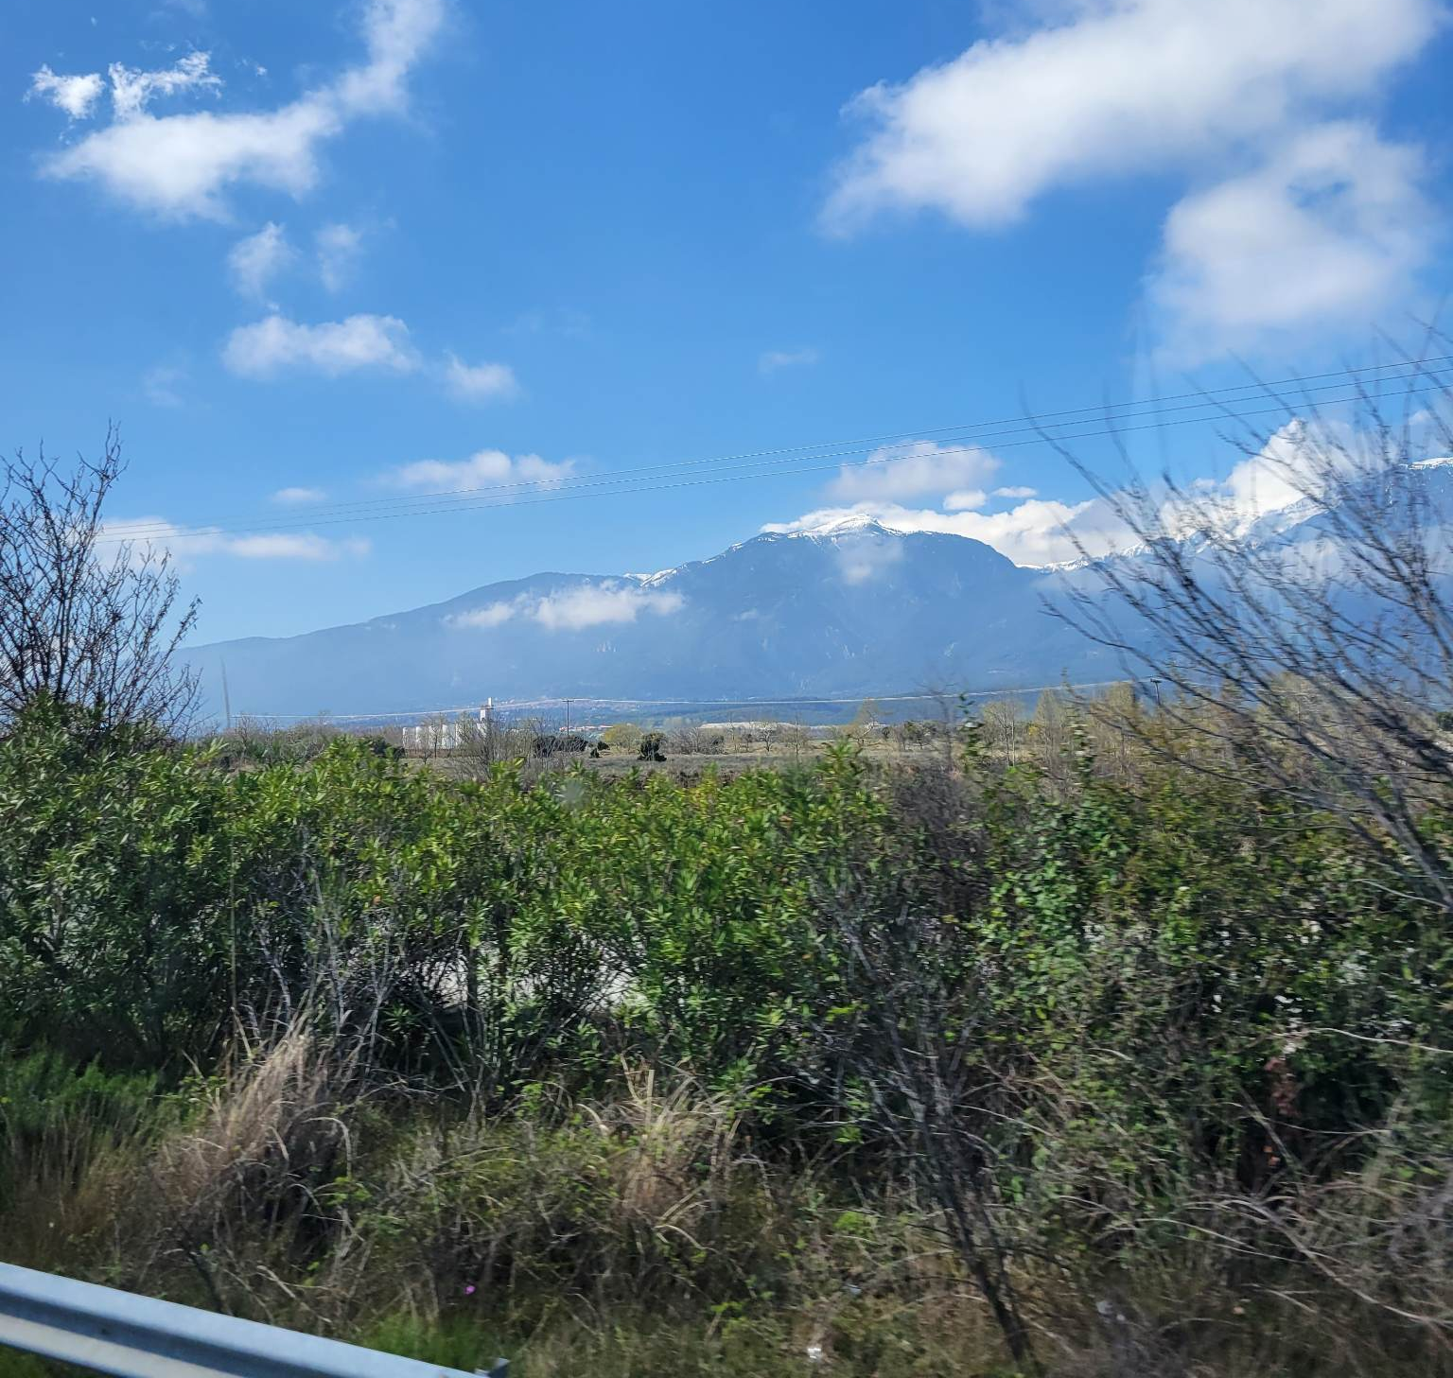
ERASMUS+2022/2023
26.03.2023-06.04.2023

Slide 2
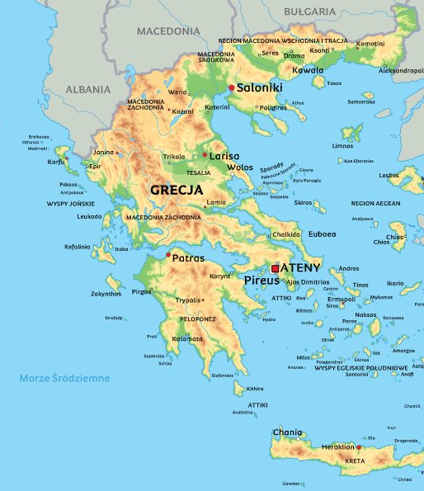
LOCATION OF GREECE
Greece is located in the southeast of Europe. It has access to many seas and has many islands (about 2500).

Slide 3
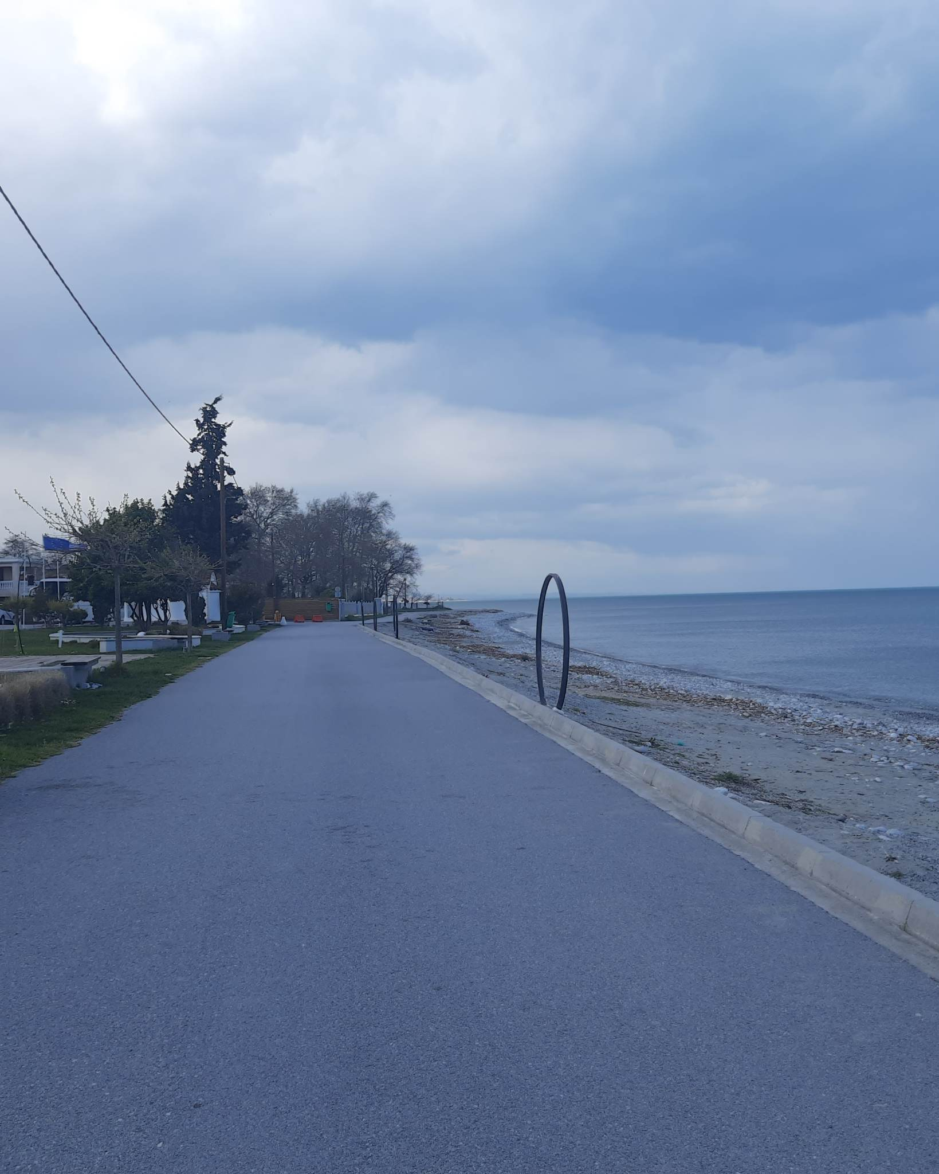
AFTER A LONG JOURNEY, WE CHECKED INTO THE POSEiDON PALACE HOTEL.

Slide 4
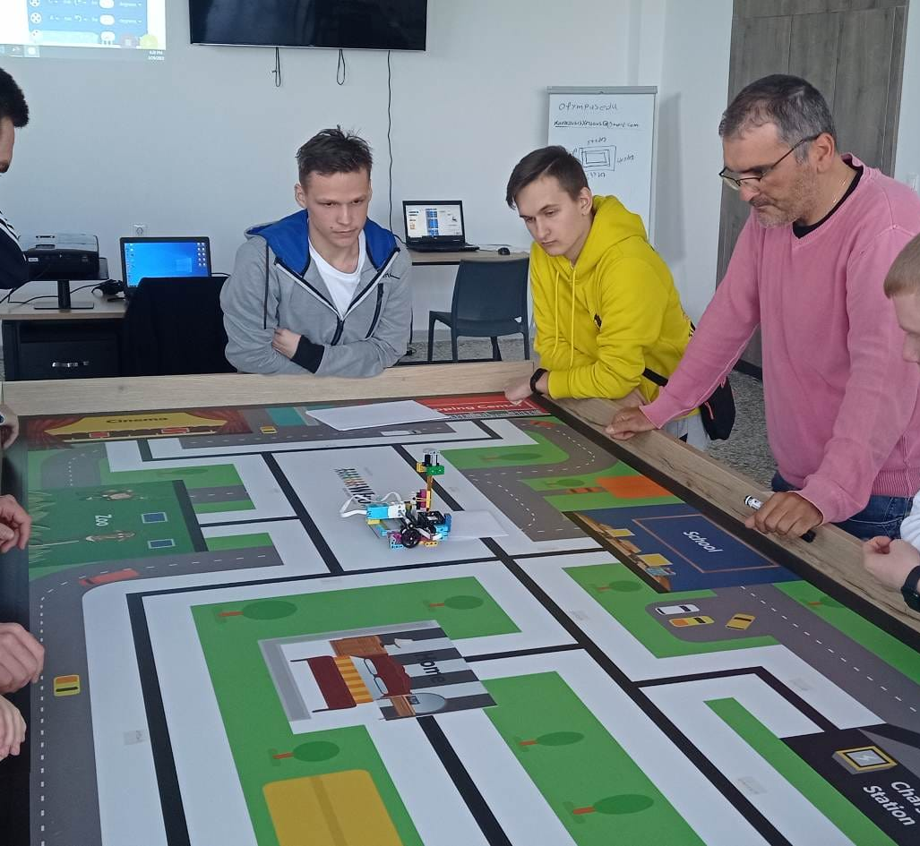
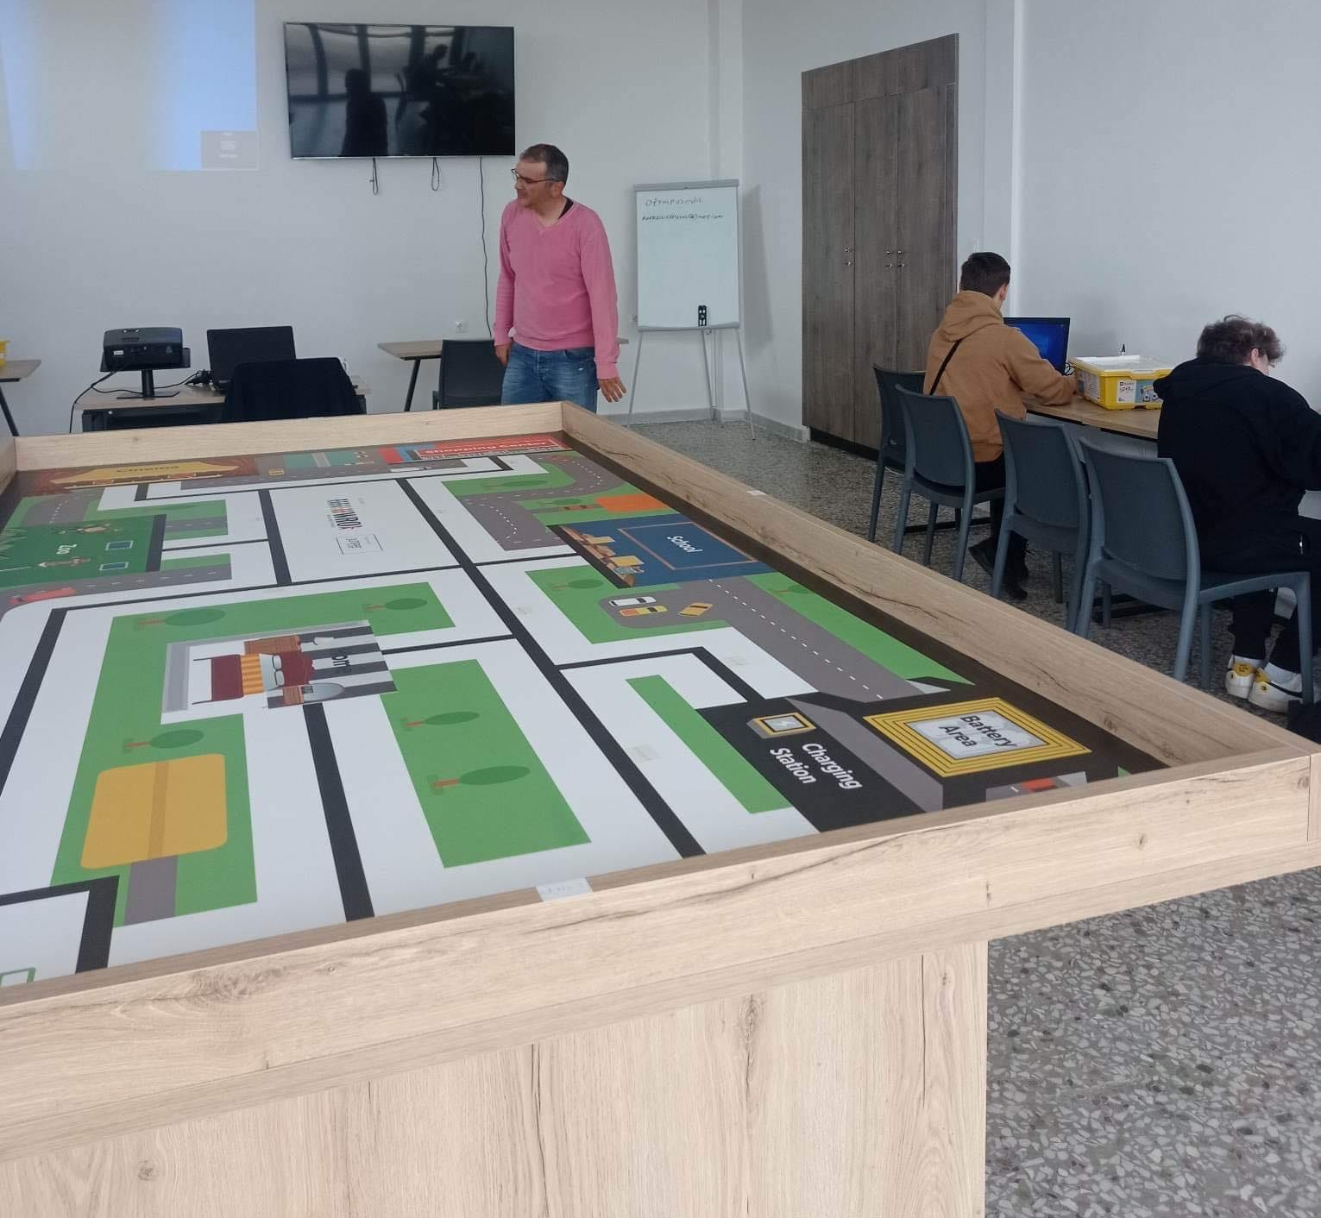
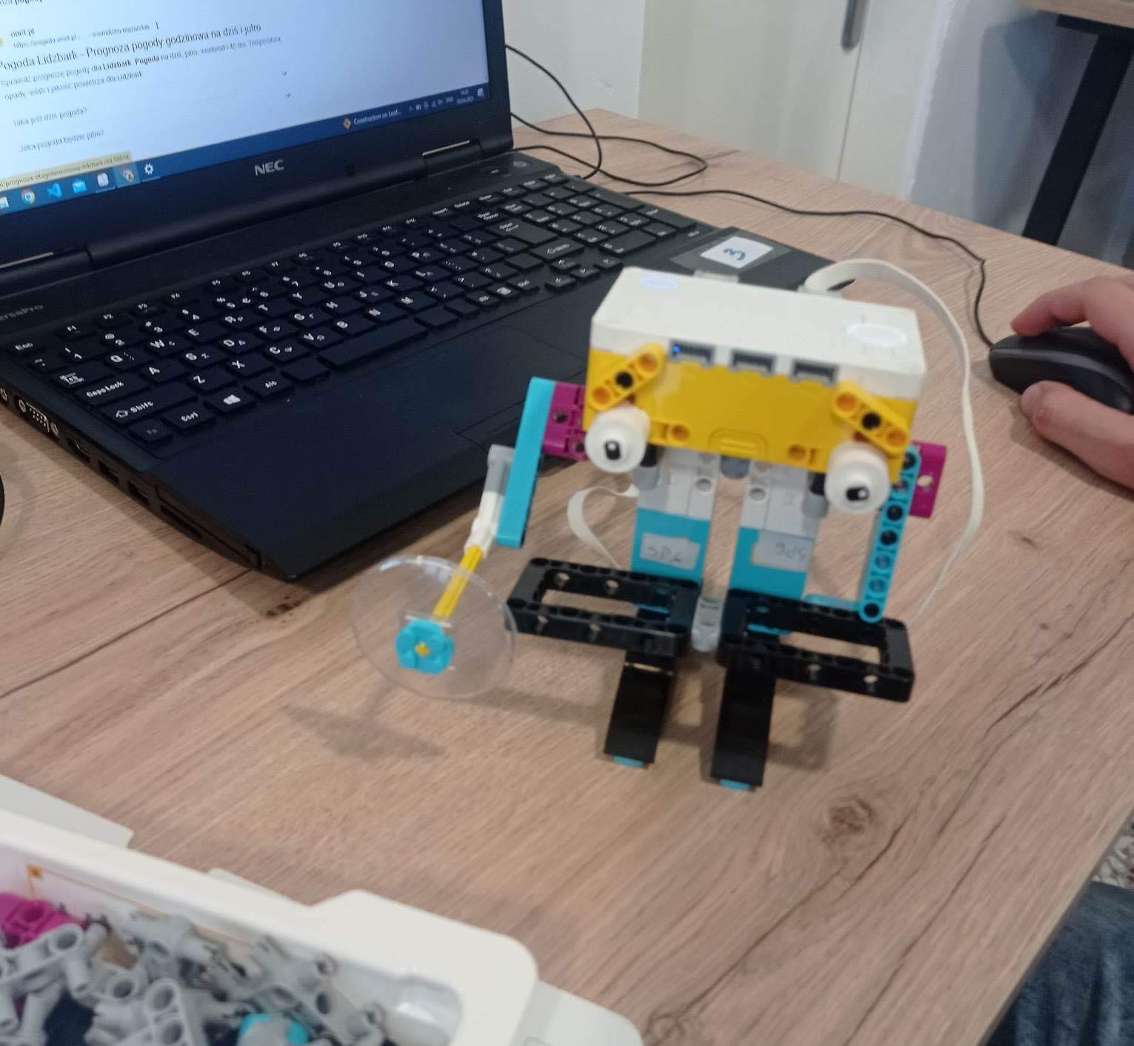
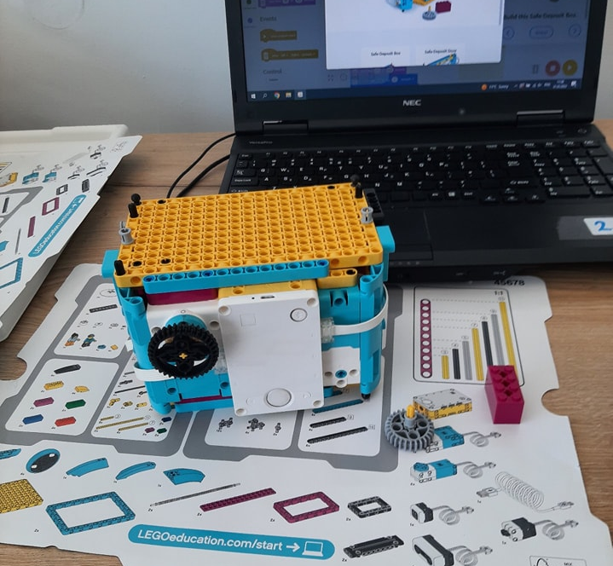
Traineeships related to the programme erasmus +
During our stay in Greece, we had an internship in robotics at the OES center in Platamonas with Mr. Xristos.We learned how to create LEGO robots and program them in SPIKE.
The first day of practice we put together a car that drove on the roads
On the second day, we assembled a robot that drew a square
On the third day, we folded the safe and the cipher into it
And on the fourth day of practice, we put together a robot that reported the weather for the next few days

Slide 5
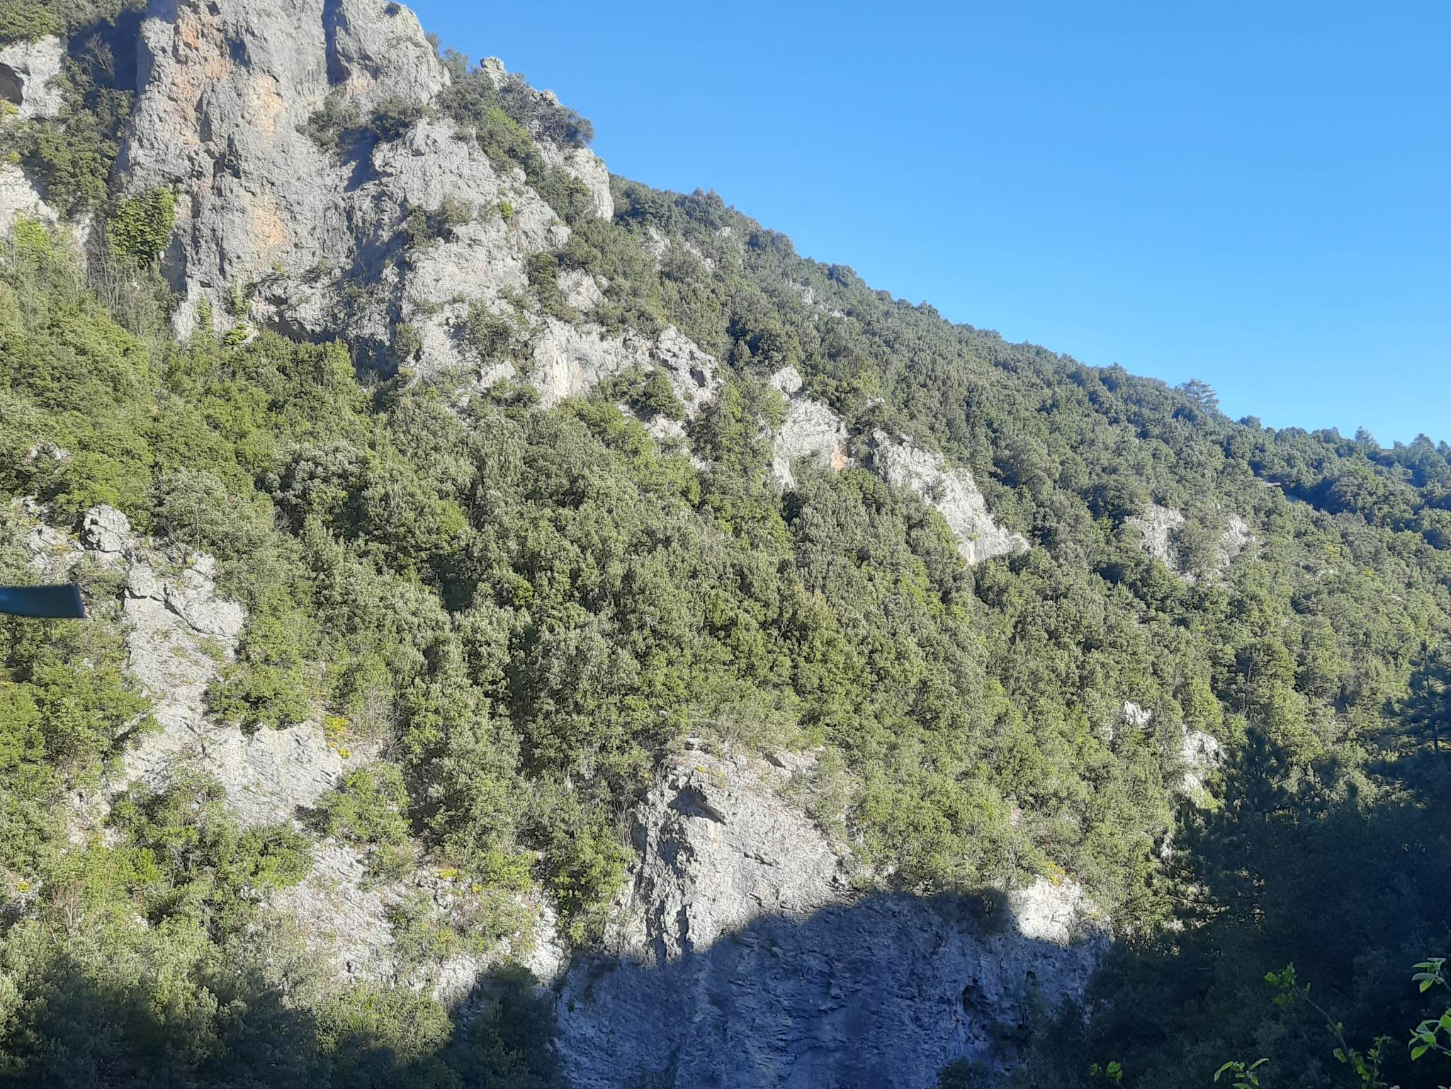
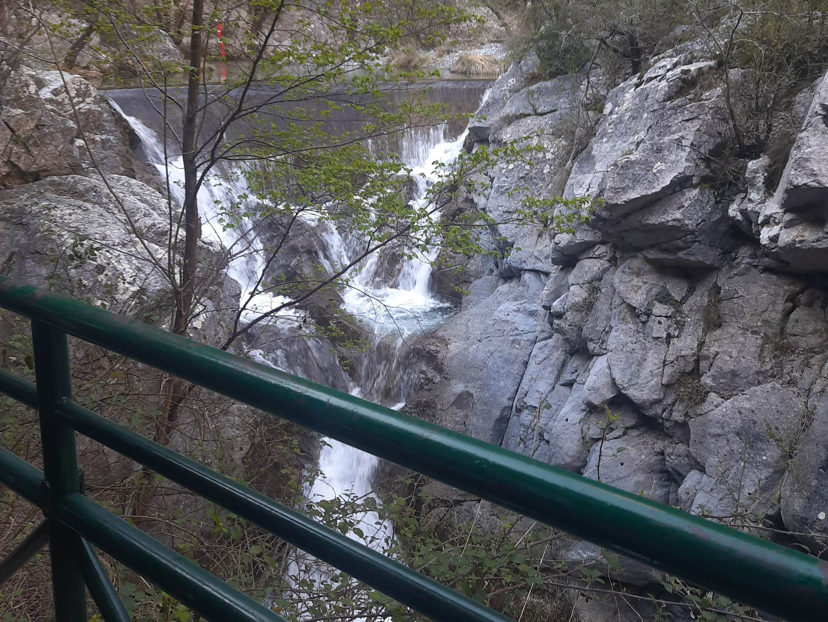
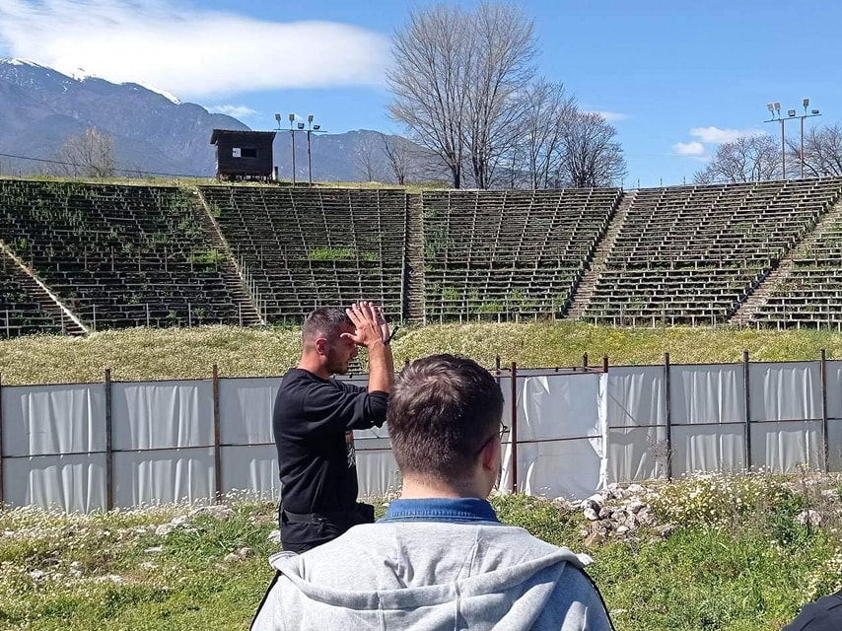
WE VISITED MANY INTERESTING AND BEAUTIFUL PLACES.
On the third day we visited:
Hellenistic Theatre of Dion
Enipeas Gorge
Litochoro Town

Slide 6
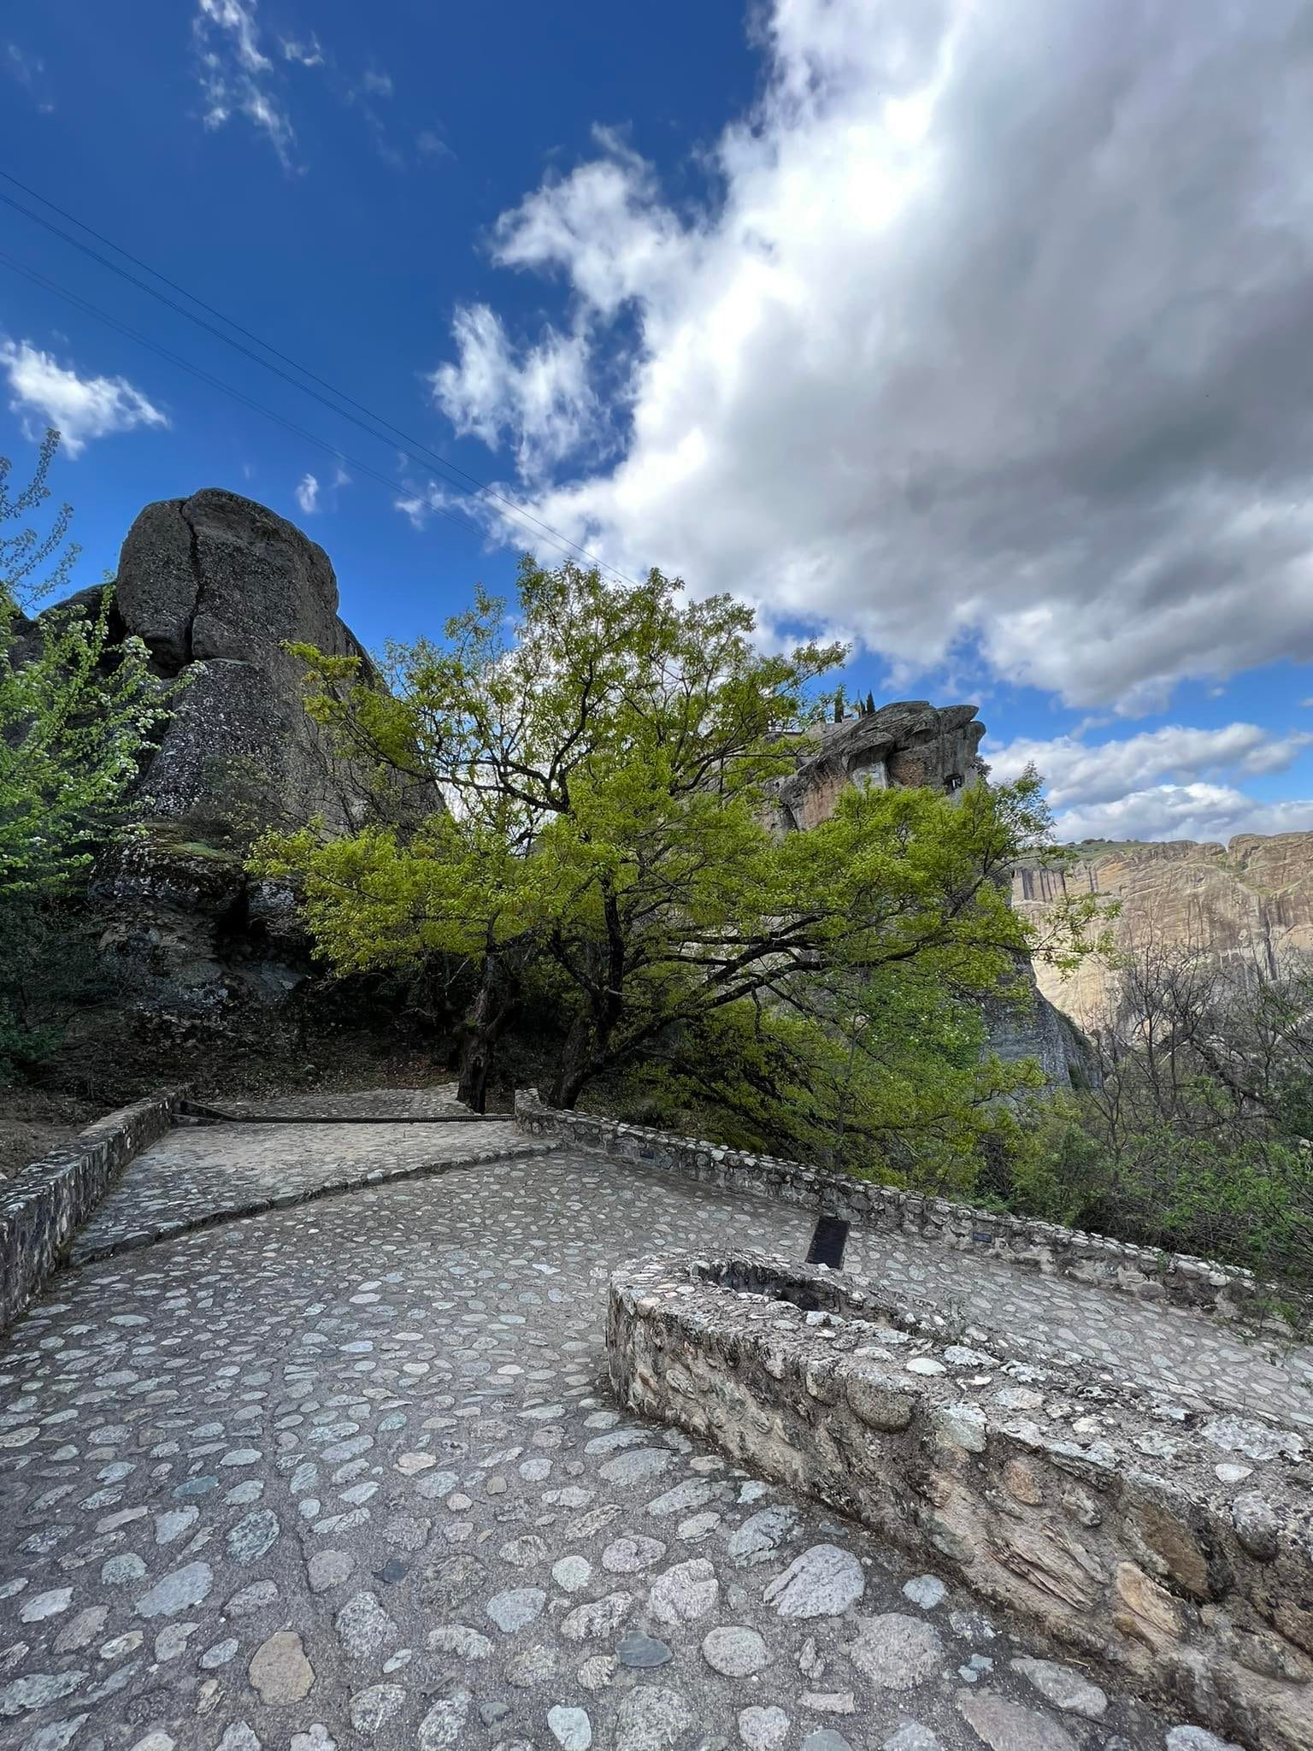
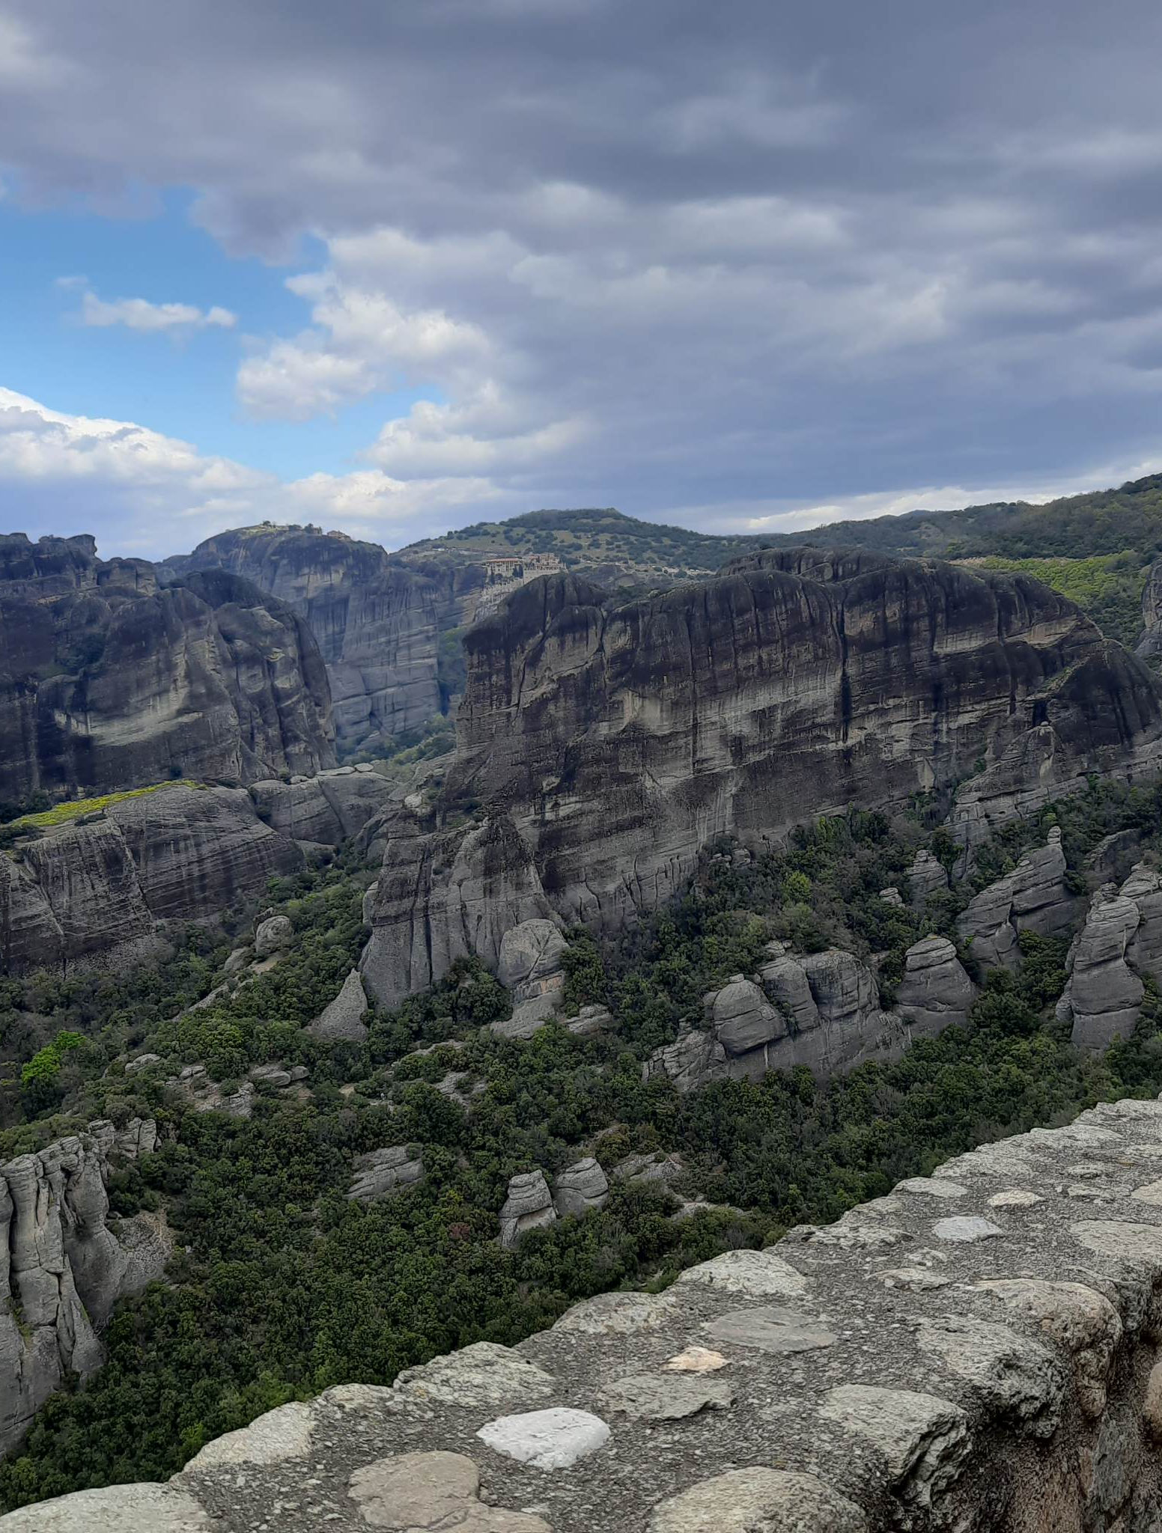
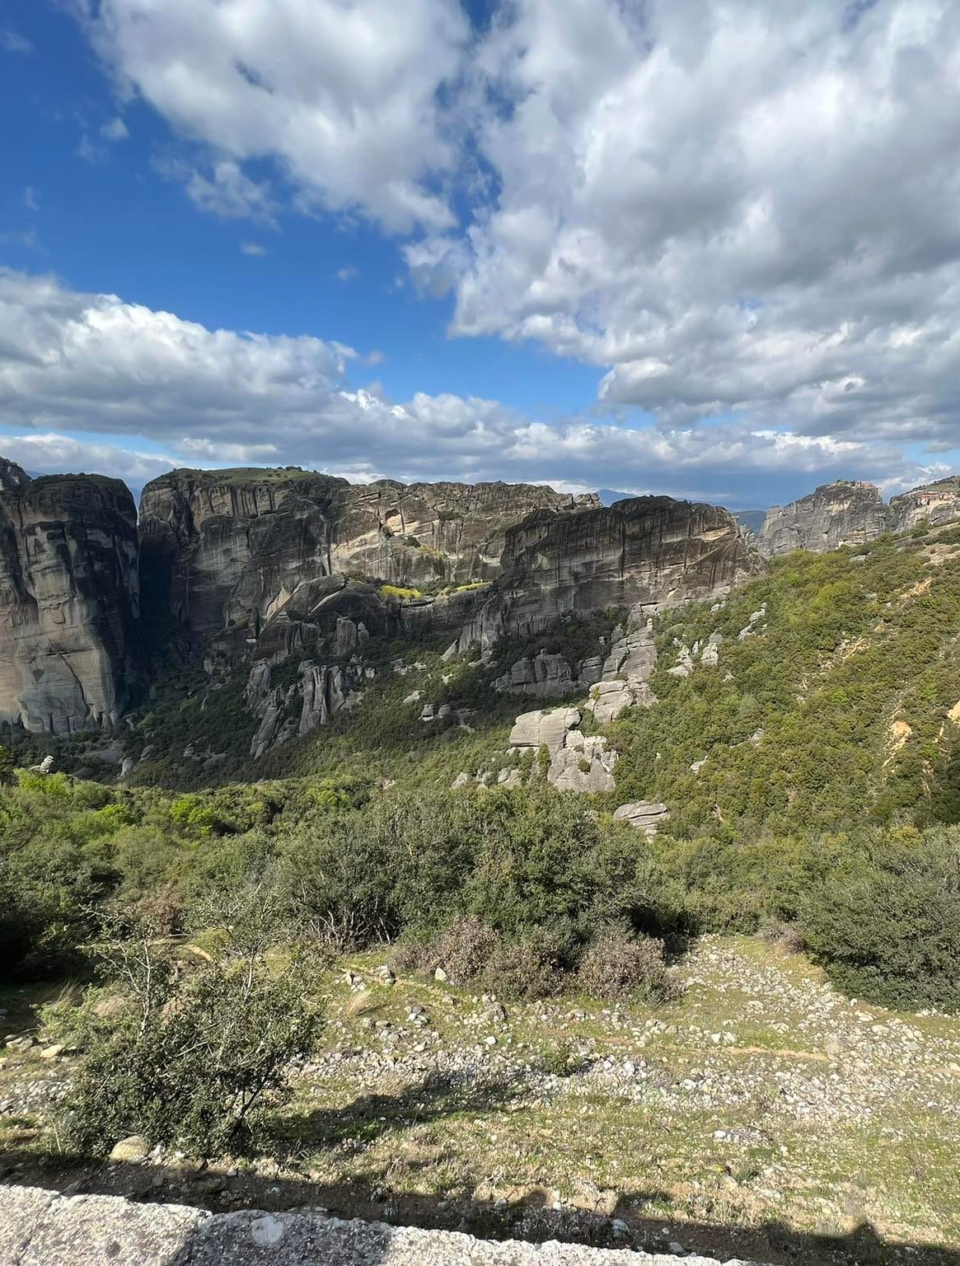
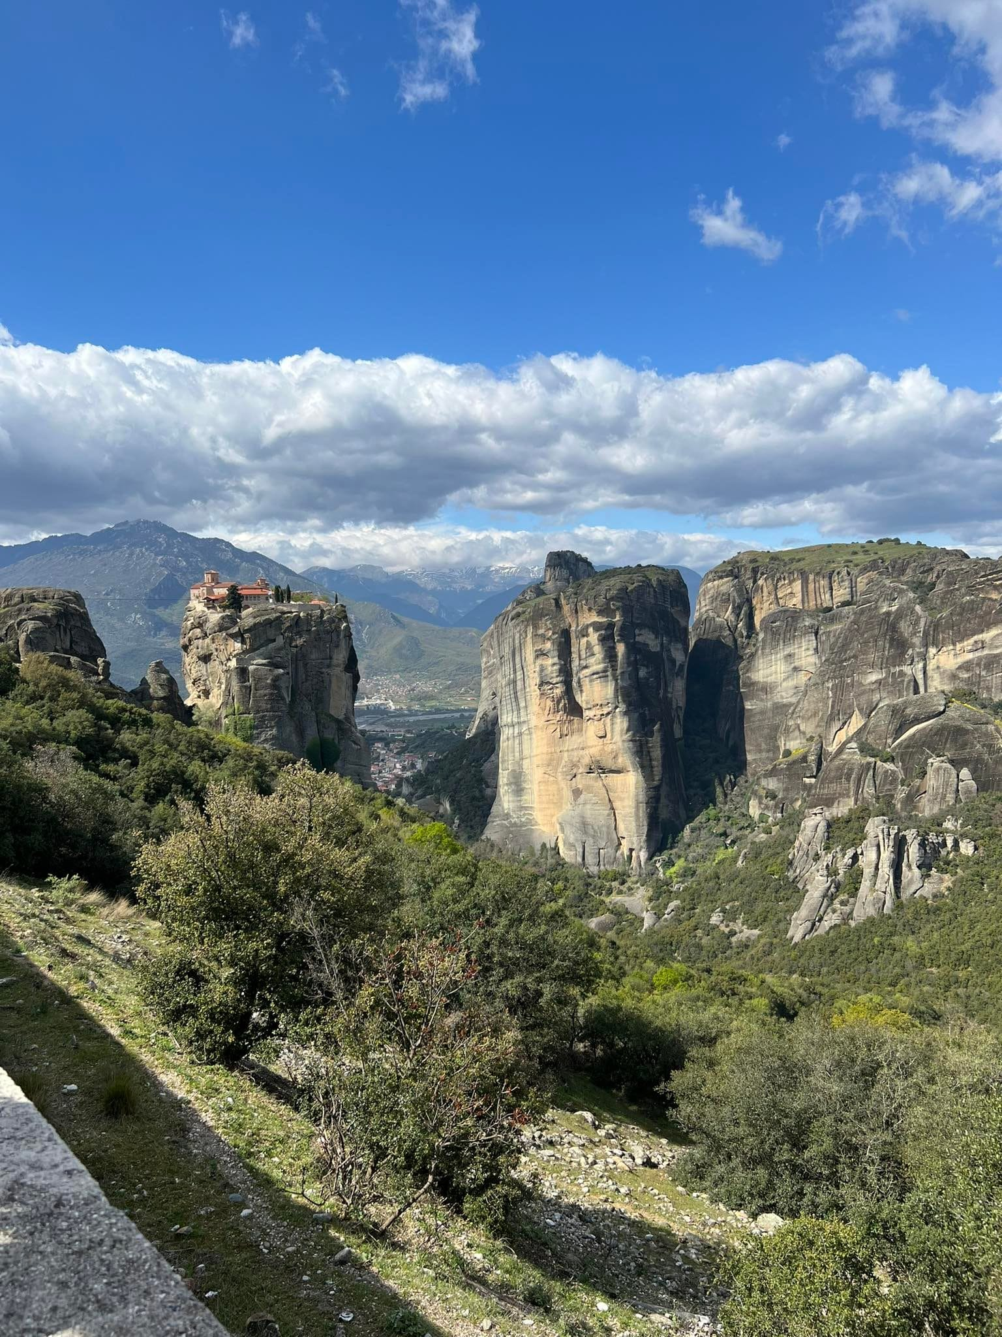
ON THE FIRST SATURDAY AFTER ARRIVAL WE VISITED METEORA (MONASTERIES ON HIGH ROCKS).

Slide 7
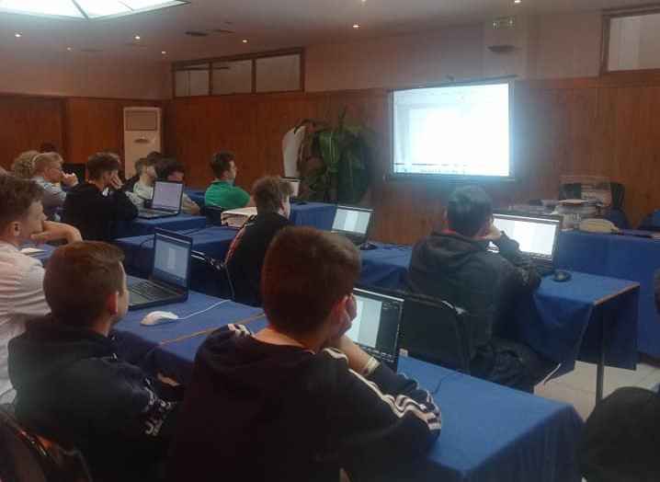
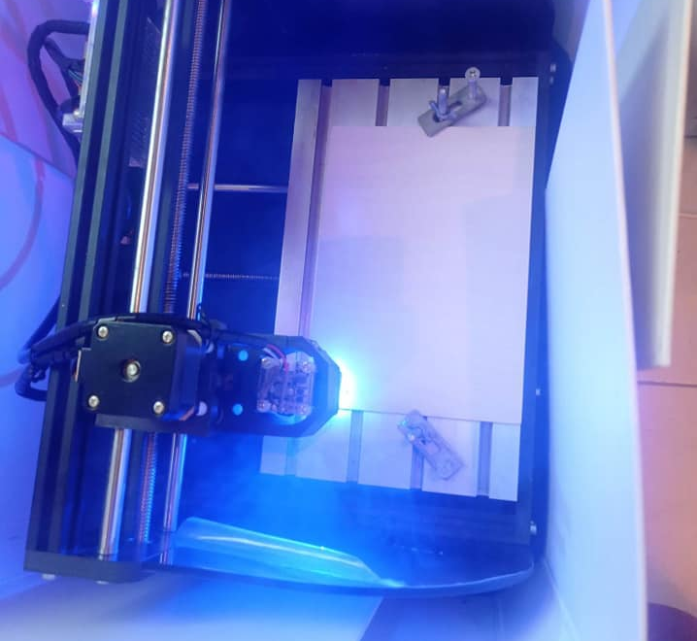
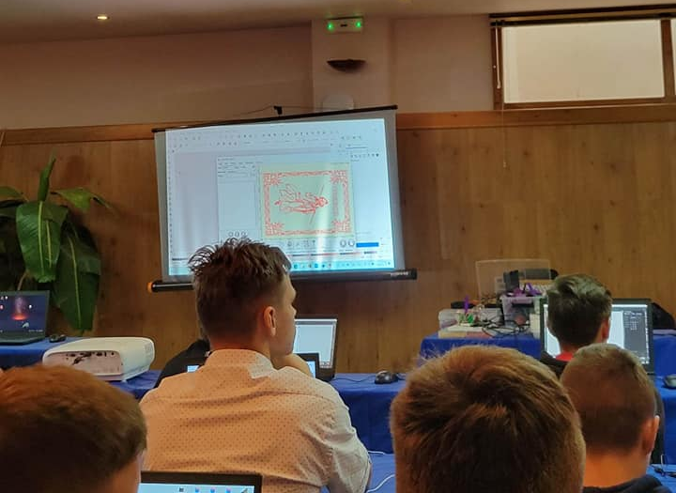
ON SUNDAY MORNING WE ALSO WELCOMED THE GRAPHICS TEACHER. HE SHOWED US THE BASICS OF VECTOR AND RASTER GRAPHICS IN INKSCAPE programe.

Slide 8
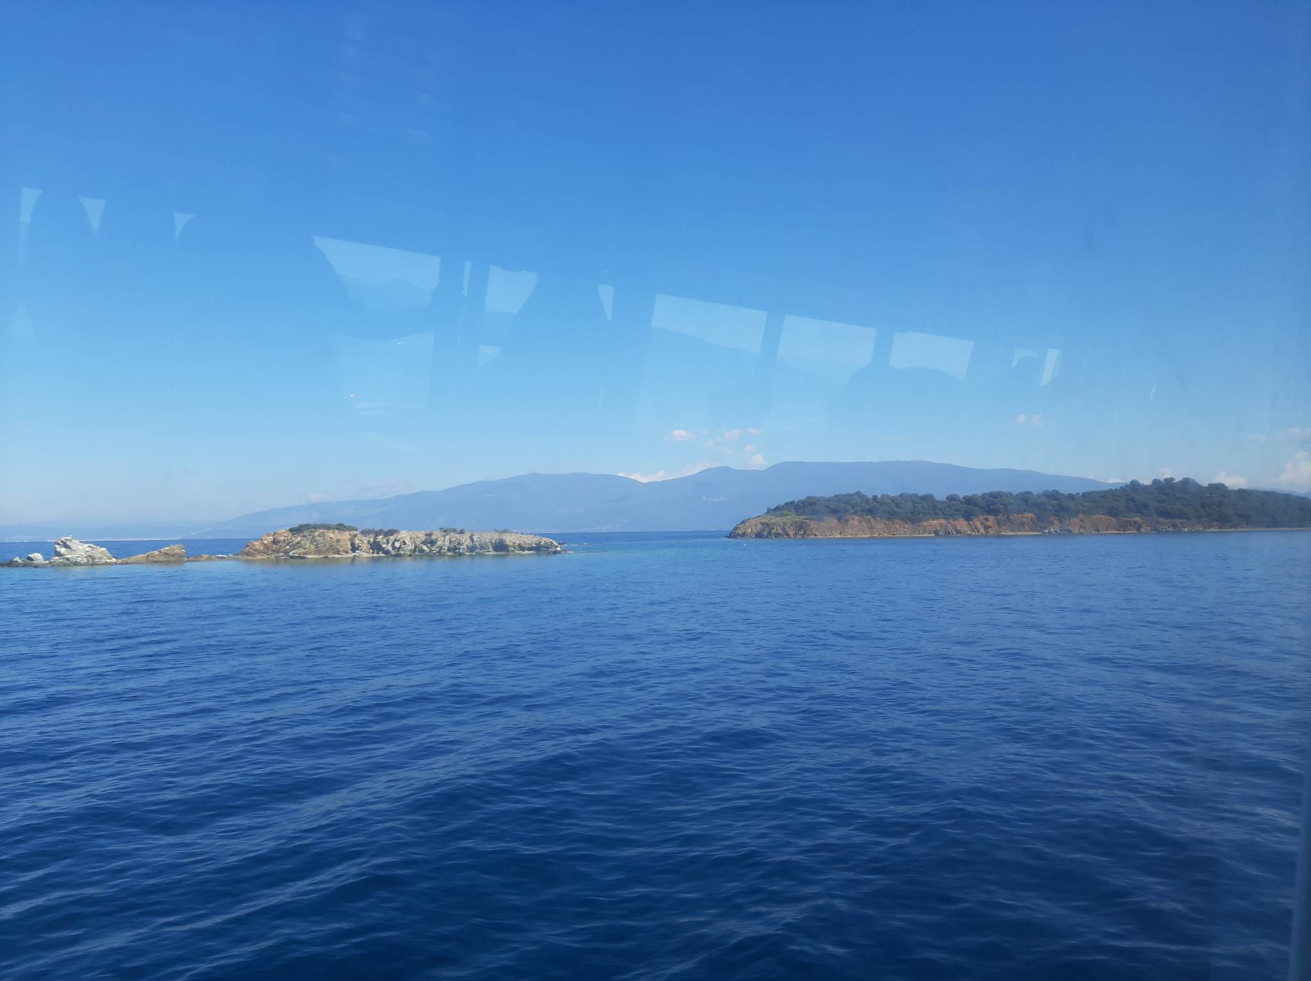
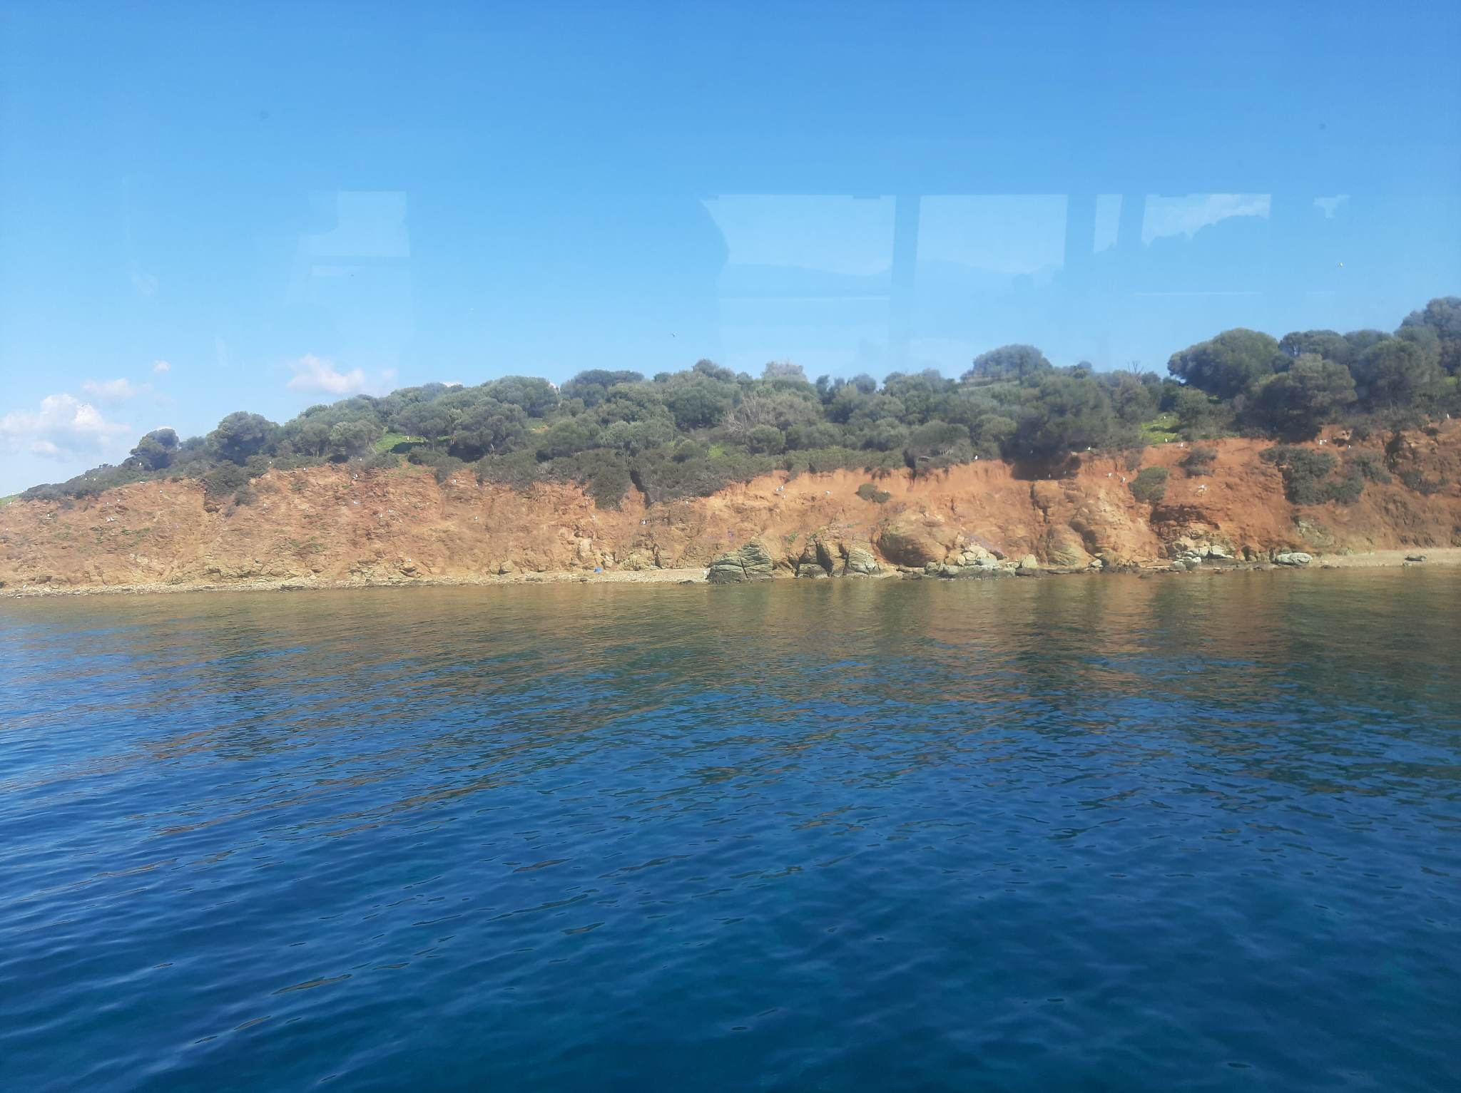
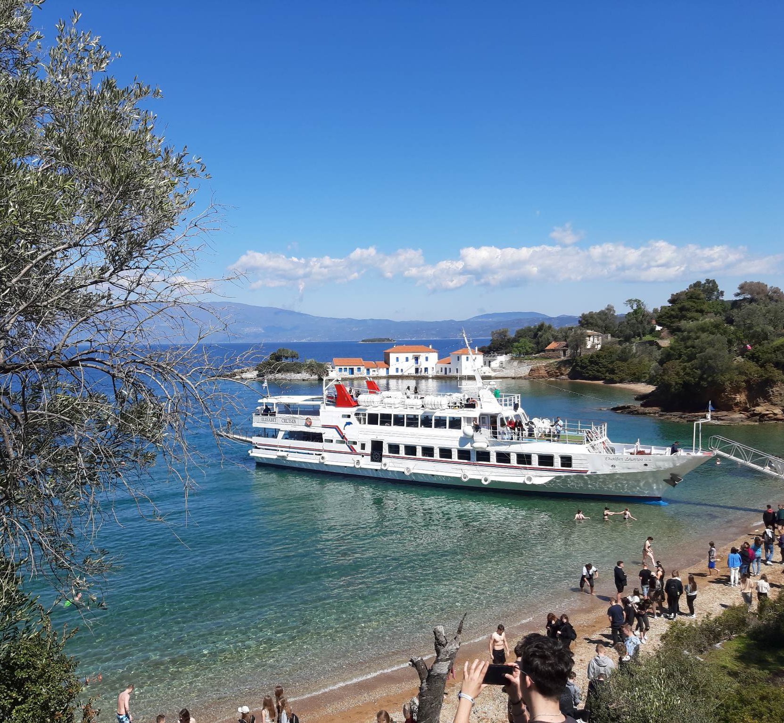
THE DAY BEFORE DEPARTURE WE TOOK A BOAT TRIP ON THE BAY OF PAGASITIKOS.

Slide 9
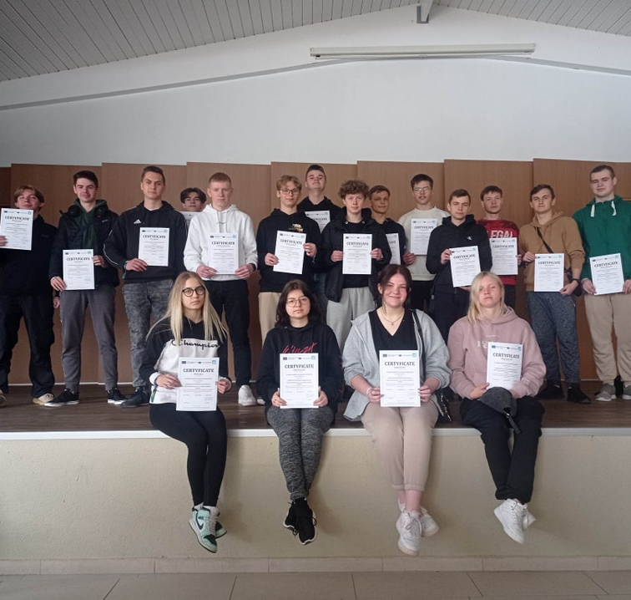
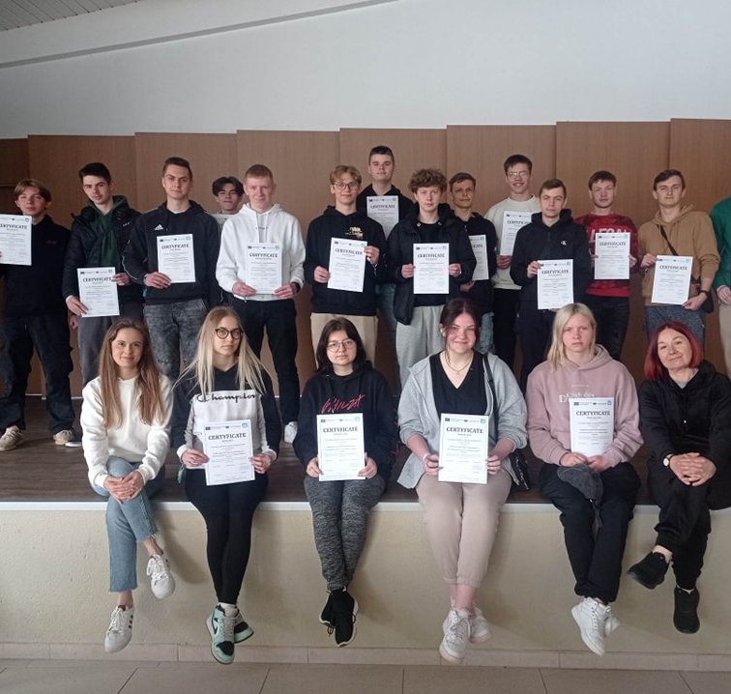
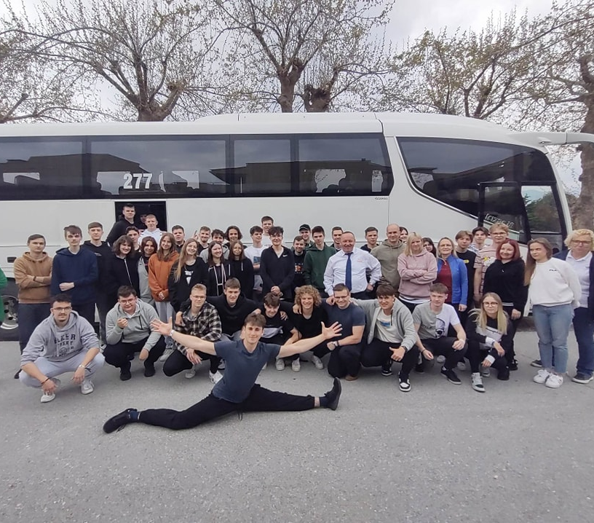
ON THE LAST DAY
DURING THE CLOSING CEREMONY Erasmus 2022/2023 We have received certificates of completion of internships.

Slide 10
THANK YOU FOR YOUR ATTENTION

