Slide 1
Classics of children’s literature

Slide 2
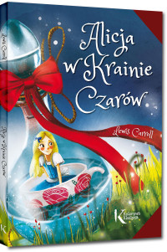
ALICE IN WONDERLAND
Author: Lewis Carroll
Title: Alice in Wonderland
The year of publishment:1865
The action takes place on two planes. The real plane is the reality of the English province.

Slide 3
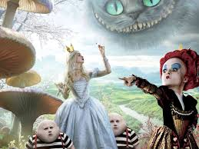
THE MAIN CHARACTERS
Alice,
White Rabbit,
Freak Cat,
Queen of hearts,
Mad Hatter

Slide 4
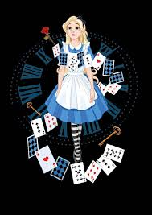
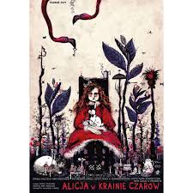
THE MAIN PLOT
"Alice in Wonderland" is primarily a story about growing up and losing child innocence. The fantastic world to which Alice gets is full of nonsense that destroys the current rules of raising a girl.

Slide 5
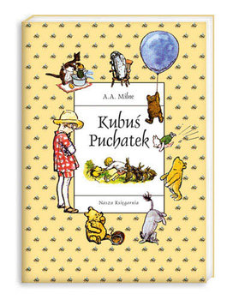
WINNIE THE POOH
Title: Winnie the Pooh
Series: Winnie the Pooh
Author: Alan Alexander Milne

Slide 6
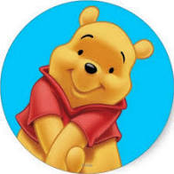
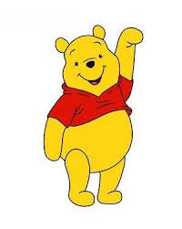
Books about Winnie the Pooh A.A. Milne belong to the classics of children's literature. The touching adventures of Teddy Bear with a very small mind, Eyesore, Piglet, Tiger and Chris in the Hundred Acre Wood enjoy and entertain not only the youngest. Animals endowed with human traits sometimes have a very philosophical approach to life.

Slide 7
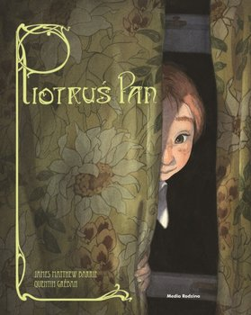
PETER PAN
Title: Peter Pan
Series: Classic in new clothes
Author: James Matthew Barrie
Release year: 2015

Slide 8
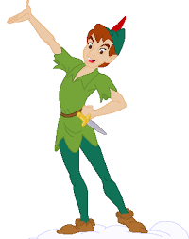
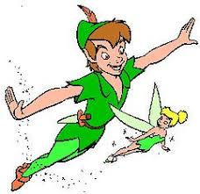
Peter the Lord belongs to the happy home of the Darling family. He is an eternal boy who never wants to grow up, a never-ending inhabitant of Neverland. There also takes three children of the Darling family, the author saw the world who do not rule all laws. But they will face Captain Hook ...

Slide 9
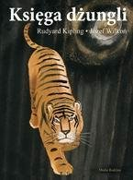
THE JUNGLE BOOK
Author: Rudyard Kipling
Translation: Andrzej Polkowski
Release year: 2009

Slide 10
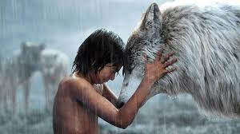
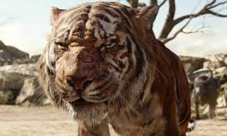
Characters: Mowgli, Bagheera, Akela, Baloo, kaa, Shere Khan, Raksha, Tabaqui, Hathi, Sachi, Father wolf.
The book describes the fate of Mauglie, a boy raised in the jungle by wolves, who won the tiger Shir Han.

Slide 11
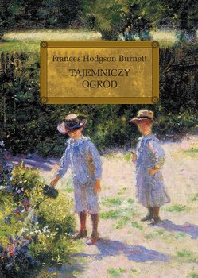
SECRET GARDEN
Author: Frances Hodgson Burnett
Translation: Andrzej Zieliński
Release year: 2008

Slide 12
Mary Lennox, after losing her parents, is given over to her uncle. He turns out to be a strange, inaccessible man. Even stranger is his house, where someone often cries, and the garden near the house that no one is allowed to enter. Mary decides to discover the cause of crying and get inside the secret garden. Whether she succeeded and what the effects were, you'll find out by reading this beautiful, wise book that has enjoyed unflagging popularity for years. It became the basis for many theater and film adaptations.

Slide 13
LITTLE PRINCESS
Author: Frances Hodgson Burnett
Translation: Birkenmajer Józef
Release year: 2014

Slide 14
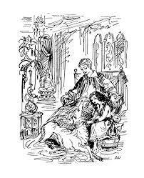
Seven-year-old Sara Crewe leads a fairy tale life. At the girls' salary in London, she is acclaimed by everyone. Has its own living room, wardrobe, pony, and even a maid! What's more, he is to inherit a great fortune from his parents. However, he is not a spoiled child - he conquers people with his innate modesty and friendly disposition.
Her life changes when she learns of her father's sudden bankruptcy and death on her eleventh birthday. From day to day, from a pet becomes a maid, and from a beautiful room moves to a cold attic. He finds refuge from cruel reality in the world of imagination. Every evening, Ermengard and Lottie sneak up to her to hear her amazing stories ...

Slide 15
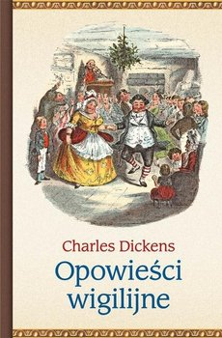
Christmas Carol
Author: Dickens Charles
Translation: Jerzy Lozinski
Release year: 2014

Slide 16
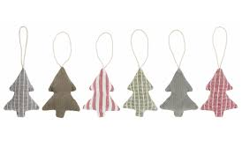
The story in the form of a morality play shows the profound transformation of Ebenezer Scrooge's miser during Christmas Eve.
Scrooge is a loner, a misanthrope disliking people, neglecting the employees of his exchange office, only interested in multiplying his wealth.
On Christmas Eve, he first appears to the spirit of Jacob Marley - a deceased business partner who in the afterlife suffers unspeakable torments for the sins of avarice and indifference to the harm he has done in his life.
The ghost's visit is to be a warning and protect Scrooge from a similar fate. Initially distrustful and disbelieving, Ebenezer changes his mind under the influence of visits of subsequent ghosts that show the hero more and more terrifying scenes from his past, present and future life ...

Slide 17
Harry Potter - a series of seven fantasy novels by British writer J.K. Rowling. The cycle presents the world of magic, i.e. the wizarding community, existing in parallel to the non-magical, so-called Muggle world.

Slide 18
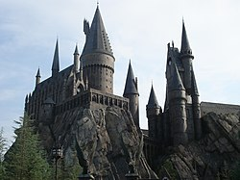
Main characters: teenage Harry Potter and his friends: Ron Weasley and Hermione Granger, students of the School of Magic and Wizardry at Hogwarts.
The most important plot of the novel: the fight of wizards, in particular Harry, with the sorcerer Lord Voldemort, seeking to gain immortality and seize power
in the world of magic.

Slide 19
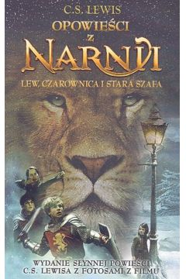
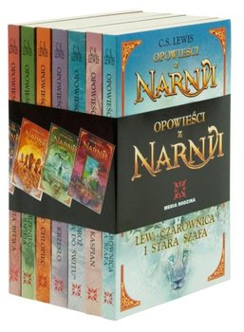
THE CHRONICLES OF NARNIA
Author: C.S. Lewis

Slide 20
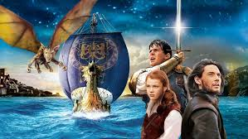
C. S. Lewis wrote seven volumes of "Chronicles of Narnia." These works belong to the classics of children's and youth literature. Despite the fact that they were created in the 1950s, they do not lose their relevance and continue to entertain, teach and inspire subsequent young generations of readers. Adults will also find wisdom in Lewis's novel that they may want to follow in their lives. What will be the fate of the heroes? Will good triumph over evil, but will Narnia plunge into darkness and its ruler Lew Aslan will not be able to overcome the ongoing crisis in the land?

Slide 21
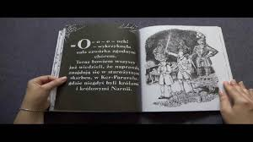
The series of seven books "Tales of Narnia" includes the items: "Lion, witch and old wardrobe", "Prince Caspian", "Journey of" Wanderer to Dawn "," Silver chair "," Horse and his boy "," Wizard's nephew "and "The last battle."

Slide 22
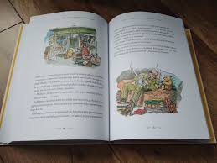
Teddy bear called PADDINGTON
Autor: Michael Bond

Slide 23
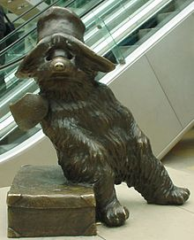
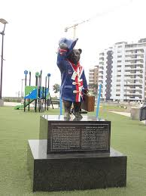
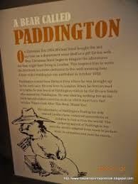
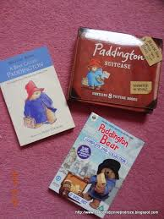
Paddington Bear fictional character of a bear cub, which was created by the English writer Michael Bond.
The first book about Paddington bear appeared on October 13, 1958. The author wrote it inspired by a mascot he bought on Christmas Eve 1956. The mascot, teddy bear, lay alone on the shelf of a London toy store. Michael Bond felt sorry for the lonely bear and decided to give it to his wife.
Paddington bear, reminiscent of a teddy bear more than a real bear, appears in 14 children's books and animated films.
The bear was born in Peru, in England contained a strange luck. The Brown family found him at Paddington station in London and gave him a name in her honor. The bear has a calm temperament, he is the helper of the Bird and Brown ladies. However, his clever neighbor likes to use it. He is friends with Mr. Gruber, the owner of an antique shop on Portobello Road. He also knows all the buyers there. The bear cub is good, kind, polite, although he also has various troubles. He often plays with Jonathan and Judith.

Slide 24
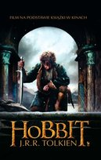
Title:The Hobbit, or There and Back Again
Author:nJohn Ronald Reuel Tolkien
J.R.R. Tolkien wrote The Hobbit in the 1930s. He gave up a world in which the inhabitants of Middle-earth are not only humans, but also hobbits, trolls, dwarves, elves and a number of other creatures known from myths and legends.

Slide 25
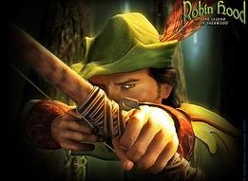
Prezentację przygotowała: Julia Lubińska, kl. VI a

