Slide 1
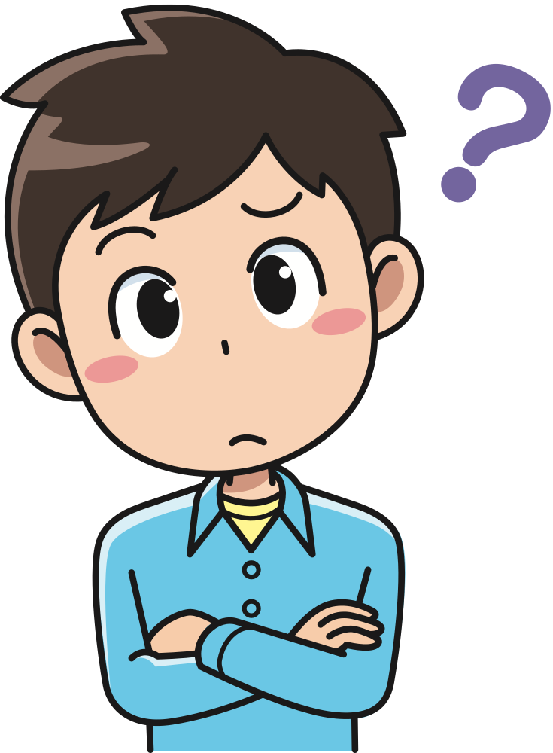
WORDS
STARTING
WITH…
Príloha č. 12

Slide 2
You have one minute to write them down….

Slide 3
READY

Slide 4
SET

Slide 5
GO

Slide 6
R

Slide 7
J

Slide 8
W

Slide 9
B

Slide 10
Y

Slide 11
N

Slide 12
F

