Slide 1
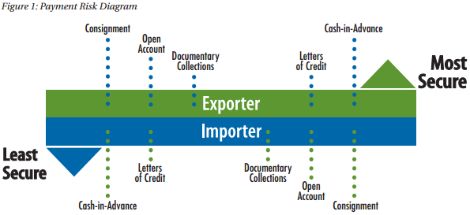
Methods of payment
Príloha č. 10
ADK BiOA

Slide 2
1. Payments through banks
Online banking
Cheques
Bank giro credit
FPS or BACS
Electronic Funds Transfer (EFT)
Banker´s drafts

Slide 3
Cheques
always payable on demand
the most common form of payment used in the home trade of countries wherer the bank cheque system has been developed
may also be used to pay debts abroad
when payment is made by checque – a separate receipt is not necessary but the payer may legally demand a receipt if required

Slide 4
Bank giro credit (BGCs)
used by customers to pay cash or cheques into a bank account
it is basically a paper slip addressed to a bank branch instructing it to credit a specified sum of money to a named account at that branch
it is not a payment instrument – i.e. it cannot be used on its own to make a payment, and must be accompanied by cash and/or cheque
can be used to pay bills in two ways:
by post with a cheque
by paying the amount into a branch of the paying customer´s own bank with cash or cheque

Slide 5
Faster Payments Service (FPS) or Bankers' Automated Clearing Services (BACS)
payments within the UK can be sent via FPS or by BACS, depending on how soon the funds are nedeed
if sending an FPS or BACS payment, you must have the receiver´s account details
if sending money abroad, you need to have the International Bank Account Number (IBAN) and SWIFT BIC (Bank Identifier Code)

Slide 6
Electronic Funds Transfer (EFT)
is a system of transferring money from one bank account directly to another without any paper money changing hands
one of the most widely used EFT programs is Direct Deposit
EFT transactions are processed by banks, and a fee is usually charged
the benefits: reduced administrative costs, increased efficiency, simplified bookkeeping and greater security

Slide 7
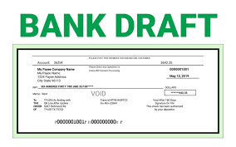
Banker´s drafts
a document bought from a bank, for which the bank will usually charge a fee
it orders the branch bank to pay the stated sum of money on demand to the person named in the draft (the payee)
in foreign transactions the payee receives payment in the local currency at the current rate of exchange
convenient for paying large sums of money in circumstances where a creditor would take a cheque in payment

Slide 8
2. Cash
if paying or receiving cash for goods, you should ensure that a proper receipt is provided for inventory and accounting purposes
3. PayPal
is an e-commerce business that enables you to pay, send money and accept payments without revealing your financial information
acts like a digital wallet where you can securely store all your payment options, such as your bank account and credit card details

Slide 9
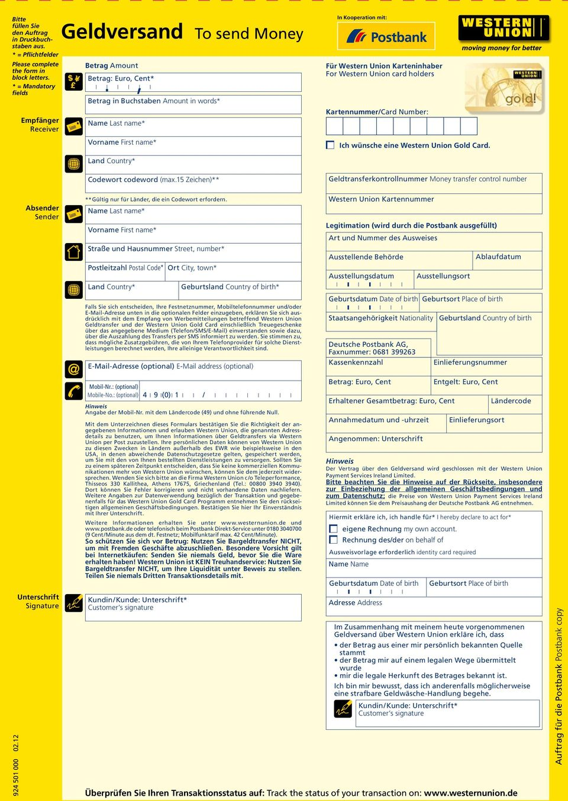
4. Western Union
enables quick and easy money transfer to most locations worldwide
in order to send funds, a sender goes to a Western Union office and presents funds (plus fees)a sender provides his or her name and address, the recipient´s name and designated payment destination – then Western Union then gives the sender a 10-digit Money Transfer Control Number (MTCN) that must be transmitted separately by the sender to the recipient – the recipient then goes to a Western Union agent office in the designated payment location, presents the 10-digit MTCN and photo ID – money is then paid out to the recipient
https://www.westernunion.com/sk/sk/send-money-online.html

Slide 10
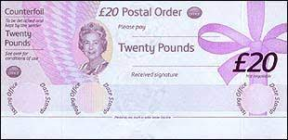
5. Payments through the Post Office
Postal orders
British postal orders are similar to cheques for those without bank accounts or those who want to avoid giving personal financial details while shopping online
look like cheques with the payment amount printed in words and numbers
available in any value up to UK £250
many countries overseas will cash British postal orders – list in online

Slide 11
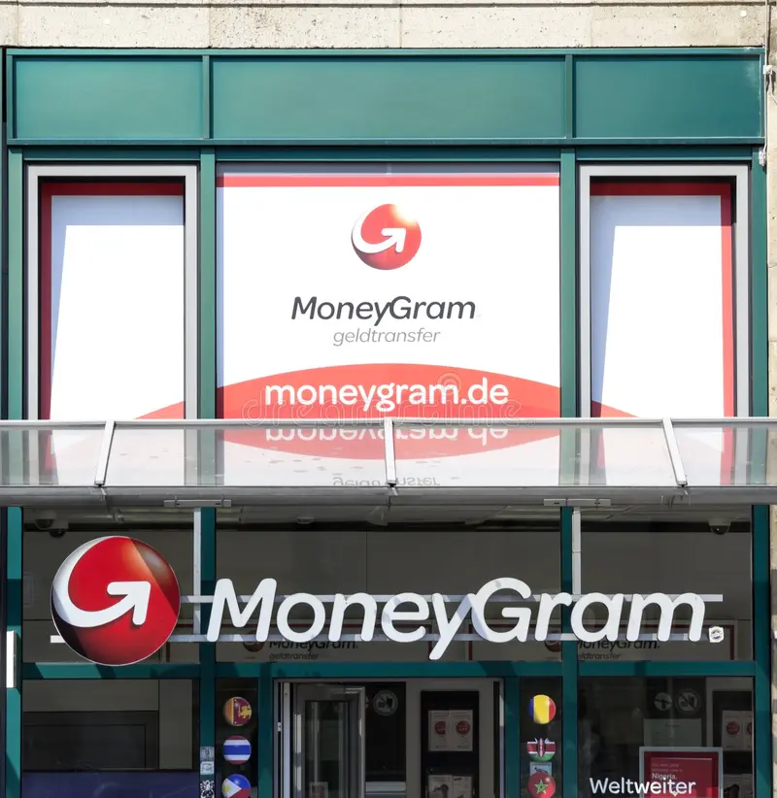
5. Payments through the Post Office (continued)
MoneyGram®
located in over 233,000 agent locations in 190 countries and territories worldwide
allow you to securely transfer up to UK £5,000 and money will typically arrive within 10 minutes
the sender will give a reference number to recipient, within 10 minutes the recipient will be able to visit their local post office with some identification, quote the reference number and receives the money

