Slide 1
Education
Created by: Adam Uhrovský

Slide 2
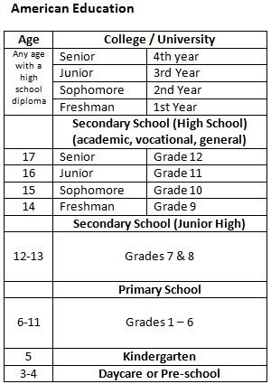
The America School system

Slide 3
Education in the United States
It is provided in public and private schools and by individuals through homeschooling
In 2013, about 87% of school-age children attended state-funded public schools, and about 10% attended tuition and foundation-funded private schools, and roughly 3% were home-schooled
According to a 2016 report published by the U.S. News & World Report, of the top ten colleges and universities in the world, eight are American

Slide 4
Daycare / Pre-school
This school has many names for example like preschool, nursery school, pre-primary school, or play school
is an educational establishment or learning space offering early childhood education to children before they begin elementary school
A child can attend this school from 3 to 4 years old

Slide 5
Children often visit daycare from Monday to Friday from 7:45am to 6pm over fifty one weeks of the year, closing for a week at Christmas
Kindergarten are equipped with classrooms with toys and educational aids like books and so on
The main goal is the personal development of children and the preparation of individuals for life in society

Slide 6
Elementary school
is a school that is the main point of delivery of primary education in the United States, for children between the ages of 5–11 and coming between pre-kindergarten and secondary education
Elementary School teachers are trained with emphasis on human cognitive and psychological development and the principles of curriculum development and instruction
The time when they ussualy start is 7am

Slide 7
High school
This school describes an institution that provides secondary education and also usually includes the building where this takes place
Some secondary schools provide both lower secondary education (ages 11 to 14) and upper secondary education (ages 14 to 18)
The time when they start is individual at almost every school

